Slide 1

Reading the English
Unlocked Literal Bible (ULB)
Notes:
Would you be able to make a PPT to show how to download the PDFs of the ULB and Notes/questions/words from BIEL? And would you also be able to make one that shows how to find the RG and choose which format and how to download it?

Slide 2

On Bible in Every Language go to the Translations Page.
Click on the ‘Translations’ link located in the top menu bar.

Slide 3
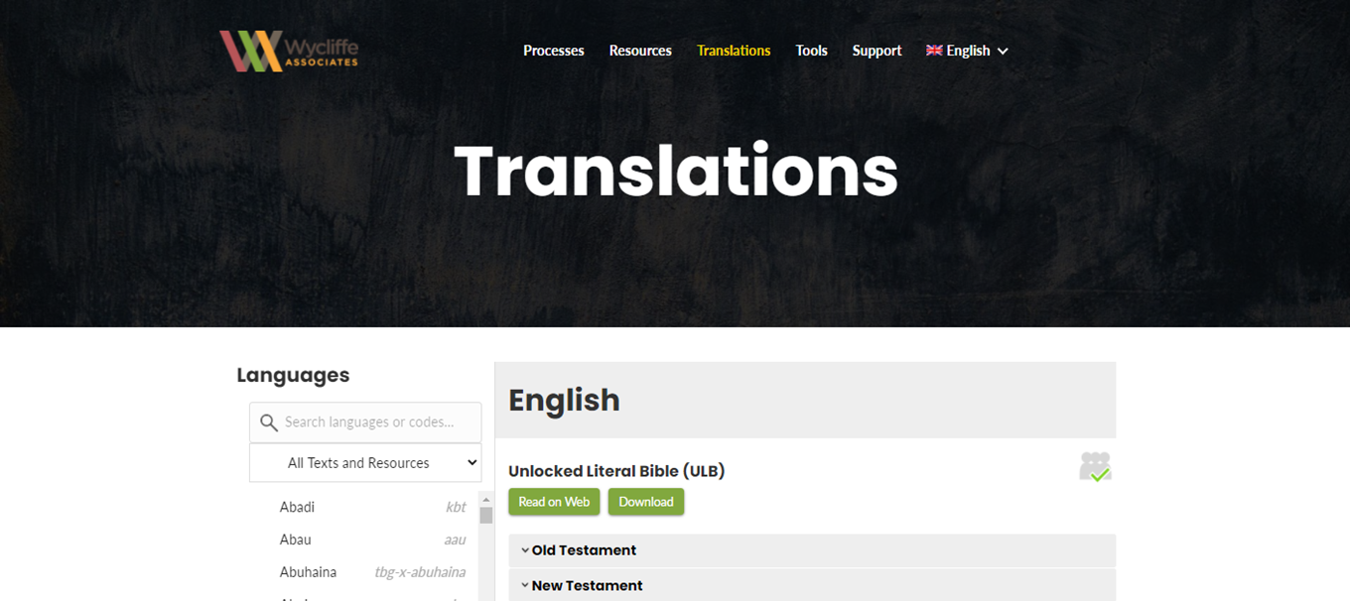
The Translations web page opens to translations in English.

Slide 4
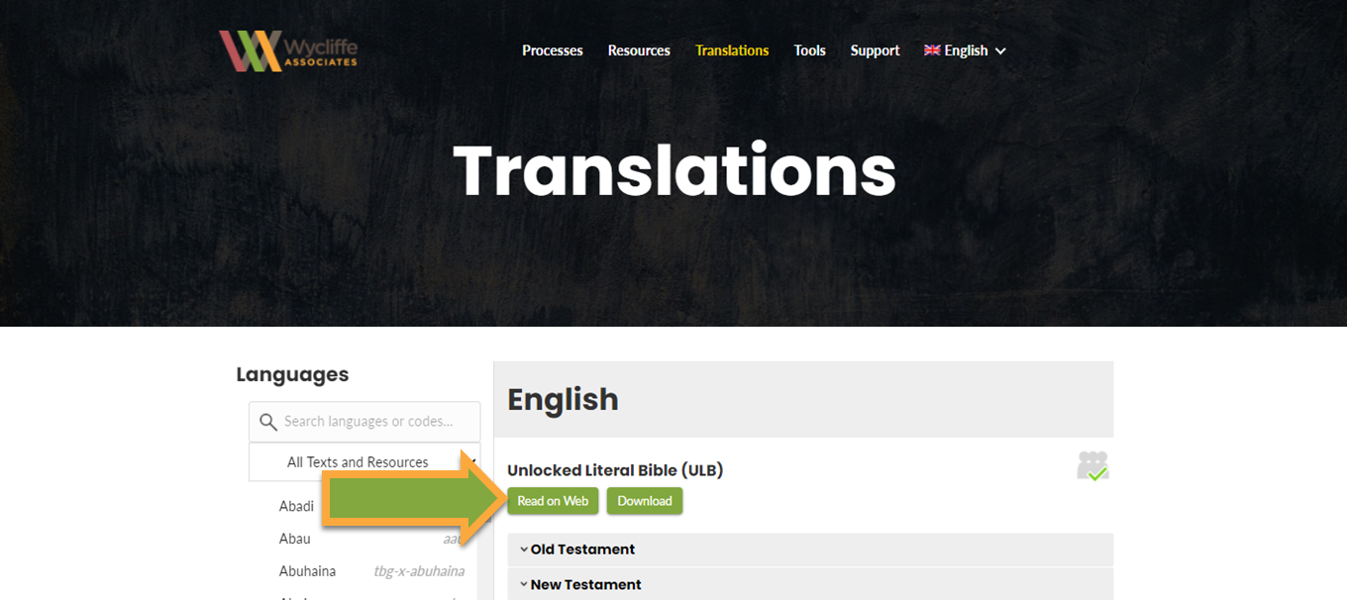
Click on the ‘Read on Web’ button to open the ULB webpage.

Slide 5
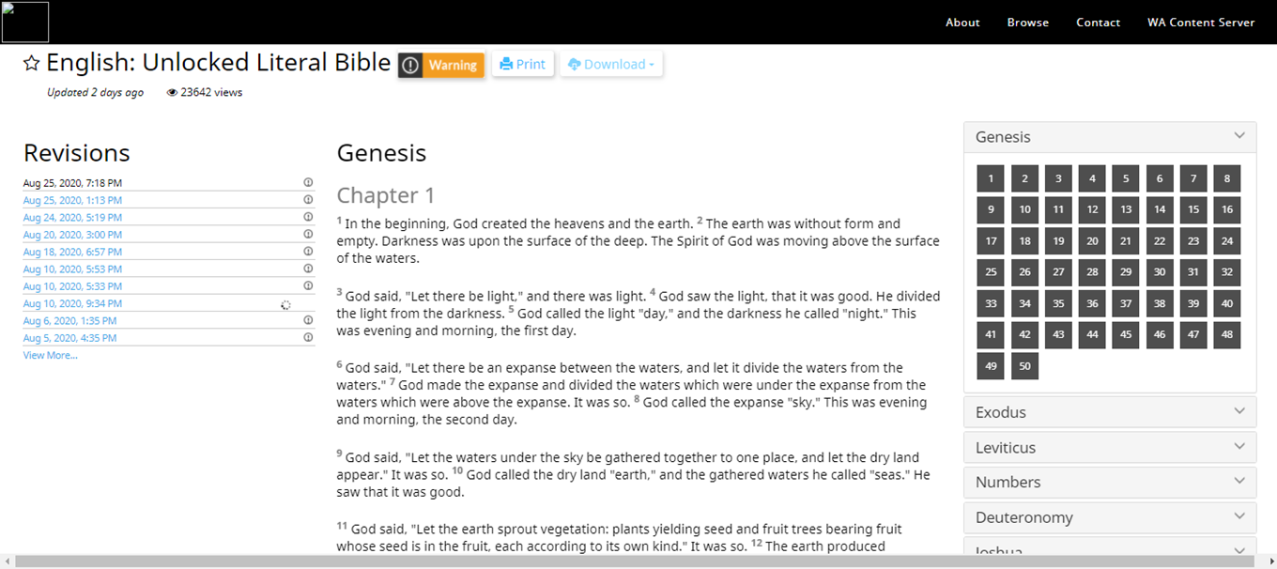
The English ULB web page opens.

Slide 6
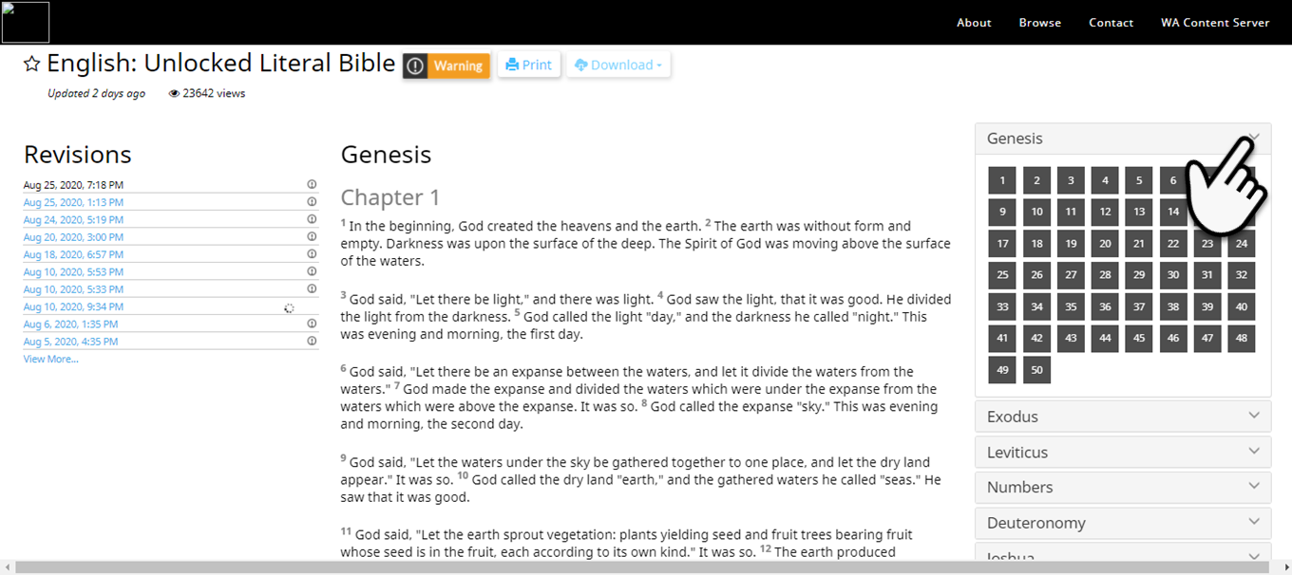
Click the down arrow to close the book menu.

Slide 7
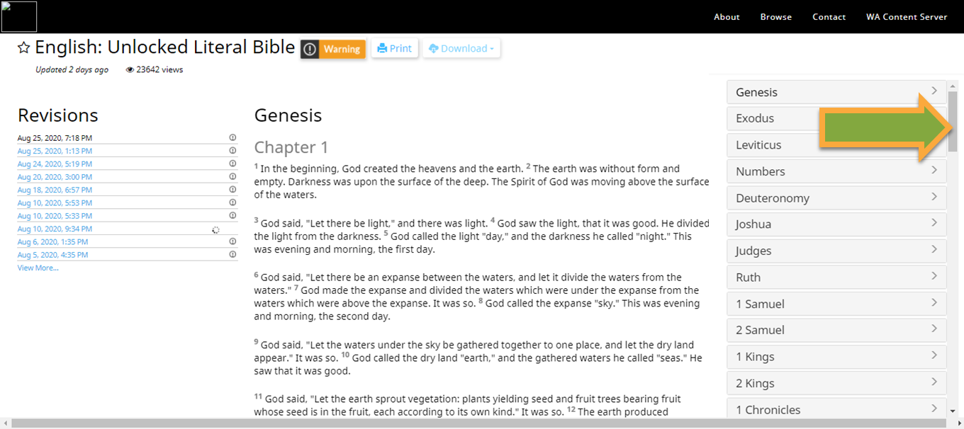
Use the scroll bar to find other books.

Slide 8
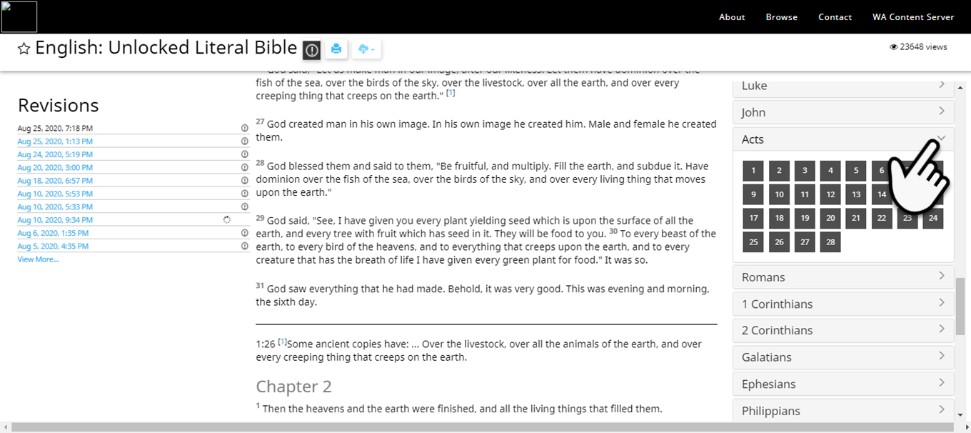
Click the down arrow to open the book menu.

Slide 9
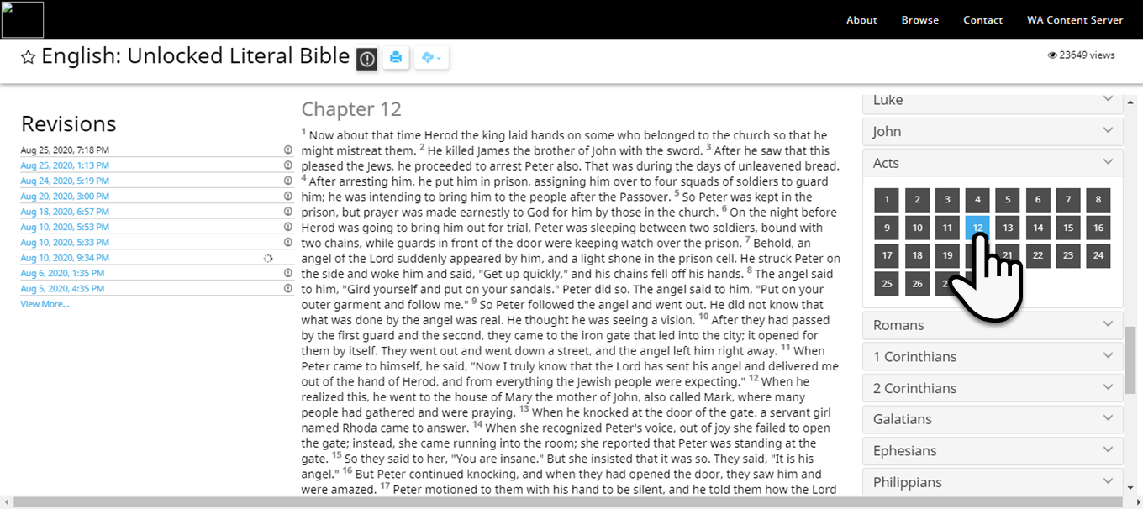
Click the number card to go to the chapter.

Slide 10
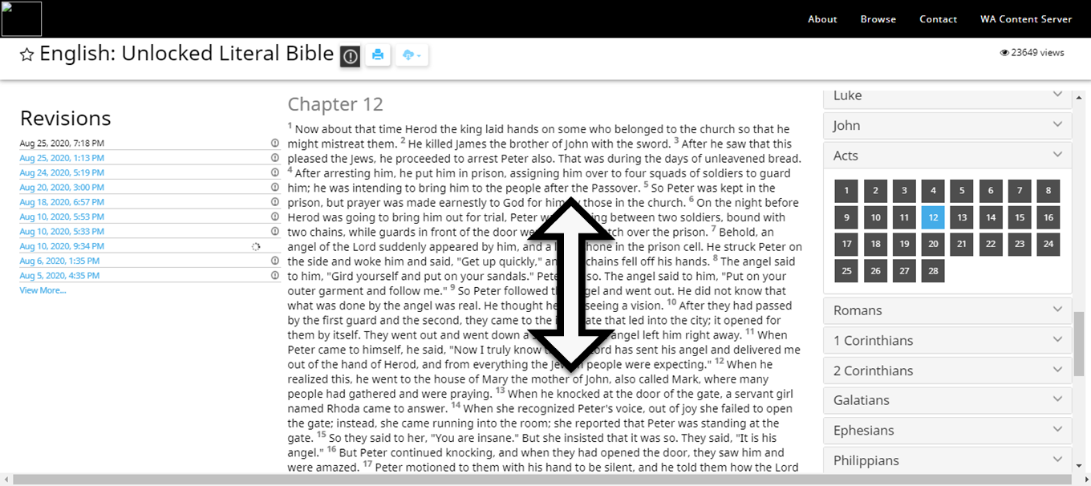
Scroll to read text.

Slide 11


